Slide 1
Integrating High-Impact Practices into First Year Experience
for Improved Learning and Persistence

Slide 2
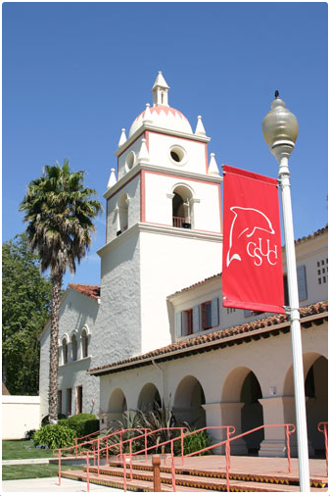
Marie Francois
Interim Director, Undergraduate Studies
University Experience Program Director
Oliver Perez
Psychology & Spanish Major
University Experience Associate
Amanda Quintero
Executive Director, Student Academic Success
and Equity Initiatives

Slide 3
AGENDA
Why develop First Year Experience Program?
FYE Model: Integrated HIP Curriculum
FYE Co-Curriculum
Peer Education and Equity Programs Toolkit Tour
Dolphin Interest Groups Simulation Activity
Professional Development & Cross-Training
Mentor-Faculty Collaboration Exercise
Impact on Retention and Student Academic Success
Scaling Up
Takeaways

Slide 4
WHY BUILD A FIRST YEAR EXPERIENCE?
Four-year grad rate of 25% -- closer to 20% for first-gen and URM students
Fall 2009 cohort:
  76% FTFT persisted to second year, 63% to third year
  73% first-gen students persisted to second year, 63% to third year
  69% Latina/o students persisted to second year, 57% to third year
  By 4th year, 41% of 2009 cohort had left; 43% first gen had left; 47% of Latinas/os had left
  WE NEEDED TO IMPROVE PERSISTENCE RATES TO GRADUATION

Slide 5
CSU Channel Islands
Hispanic Serving Institution Since 2010
Enrollment/Demographics 2015-16
Headcount: 6,167
FTE: 5,060
Hispanic: 48%
American Indian: 0.4%
Asian: 6%
Black or African American: 2%
Native Hawaiian: 0.08%
Non-Resident Alien: 0.2%
Ethnicity Unknown: 6%
Two or More Races: 5%
White: 32%
Female: 65%
Male: 35%
Average Age: 23
54% first generation
52% meet the federal criteria for Pell eligibility
99% California residents
50% from Ventura County

Slide 6
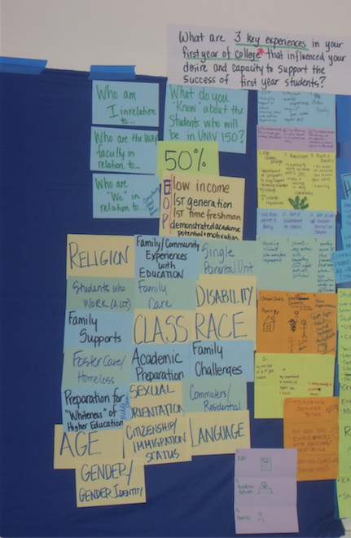
First Year Experience (FYE) integrates multiple high-impact practices:
linked Learning Communities
thematic critical thinking First Year Seminars
writing-intensive English composition classes
embedded peer mentors facilitate small co-curricular Dolphin Interest Groups (DIGs)
FYE satisfies 7 GE units.
Mentors and faculty undergo professional development in best teaching and learning practices for our local context.

Slide 7
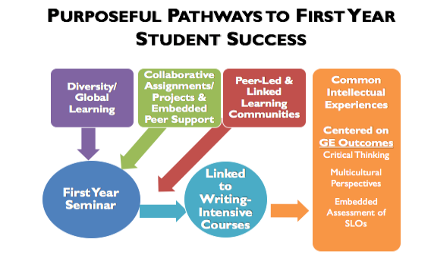

Slide 8
First Year Experience at CI
2011: 78 students
2016: 240 students, 25% in Living-Learning Communities.
Retention to the second, third, and fourth year 4% to 9% better than all freshmen.
For 173-student cohort Fall 2014, 83% retained to second year (87% for Hispanics/Latinos), compared to 79% for all freshmen.
As FYE scales up
  second-year GPAs outpace non-FYE cohorts
  greater impact for Pell, first-generation and underrepresented students
  higher percentage of FYE students are sophomores in their third semester.
UNIV 150 Freshmen Year Seminar
A 4-unit GE critical thinking course linked to a 3-unit freshman writing intensive composition course (ENGL 102 or 105) which forms a cohort based community of learners.
Linked Courses
Intersect on themes and reinforce assignments across the courses. Students move as a community of learners through the courses.
Embedded Peer Mentor

Slide 9
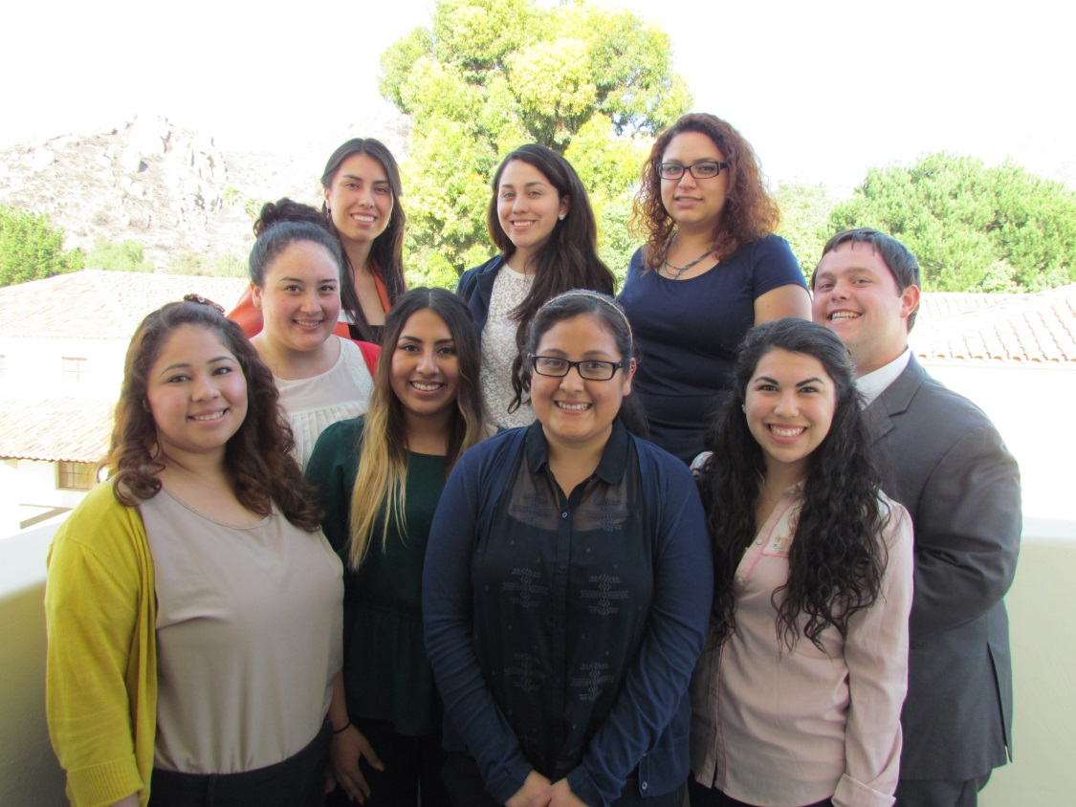
FYE Co-Curriculum: Peer to Peer
University
Experience
Associates
FYE Community – Mentors facilitate a peer academic-social support system that encourages students to build networks and participate in university culture.
Engagement – Mentors embedded in the classroom experience lead in-class and out-of-class activities related to the mission pillars & student success strategies.
Mentors – Model the university experience for students and ease transition
Coaches – Train students in good academic habits and effective academic skills

Slide 10
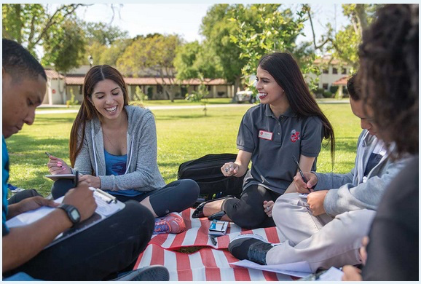
FYE Co-Curriculum
Dolphin Interest Groups “DIGs”
UEAs facilitate small student groups (4-5 students) that meet outside of class to:
  Engage students in activities focused on the university mission pillars such as the Day of Service or International Week.
  Review topics from UNIV class.
  Map syllabi/assignments from all classes.
  Learn study and time management skills
  Explore campus resources such as the writing center or STEM tutoring center.
  Attend campus events together like the Reading Celebration.
  Conduct a mid-term assessment of academic standing in all classes.

Slide 11
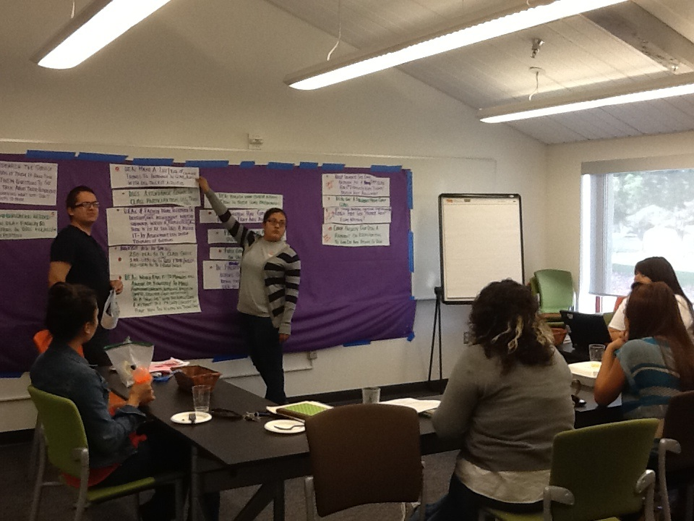
University Experience Associates
From 2011-15, paid by Title V grant; beginning Fall 2015 on general fund.
Instructional student assistants, unionized, $12/hour
Base of 12 hours/week, up to 15 hours (20 hours for two mentors who support more than one cohort).
Two weeks of training, in May and in August
UEA workload: ongoing training, team meetings, office hours, UNIV class time (attend once a week), DIG delivery, prep time, and reflection reports for program continuous improvement, oversight, and data collection.

Slide 12
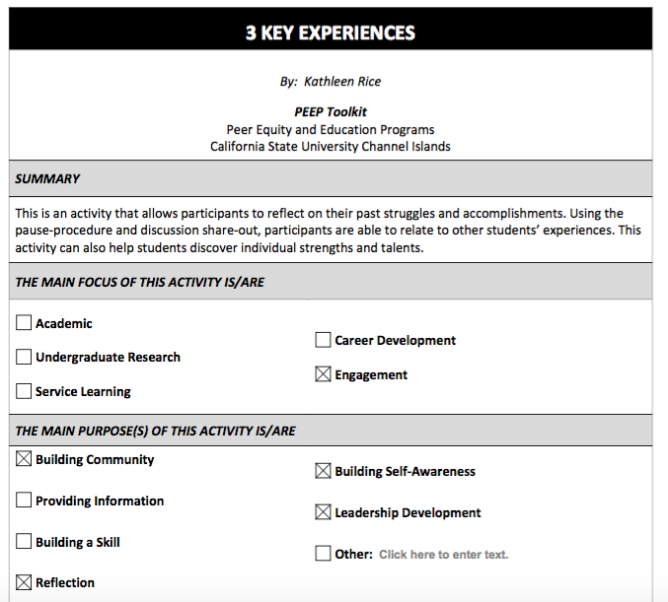
Let’s go on a PEEP Toolkit Tour!
DIG Simulation

Slide 13
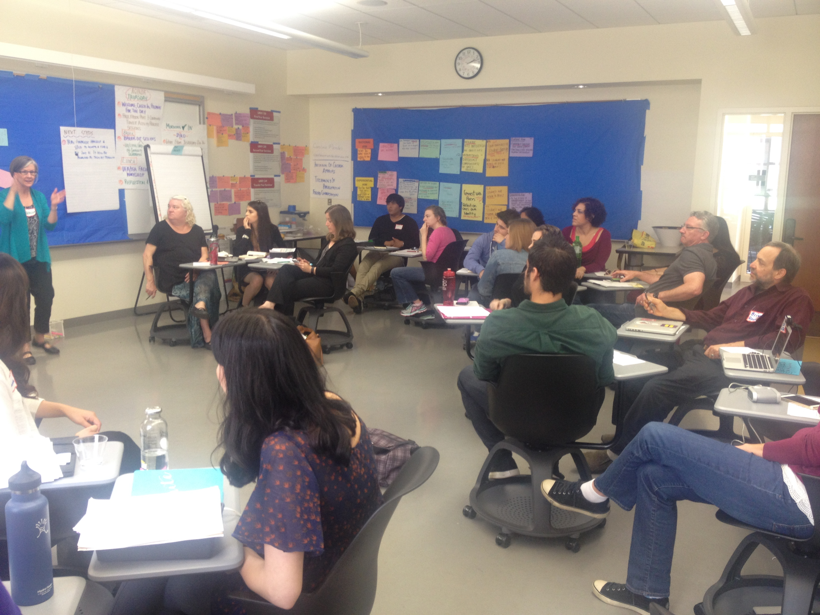
UNIV 150 First Year Seminar
UNIV 150 faculty choose theme that allows students to gain knowledge on intercultural and multicultural perspectives and to develop critical reasoning skills.
immigration, educational justice, international modernism, environmental justice, citizenship, identity formation, water issues, consumerism, sustainability.
Faculty often incorporate Campus Reading Celebration book. All faculty assign a Critical Reasoning Signature Assignment.

Slide 14
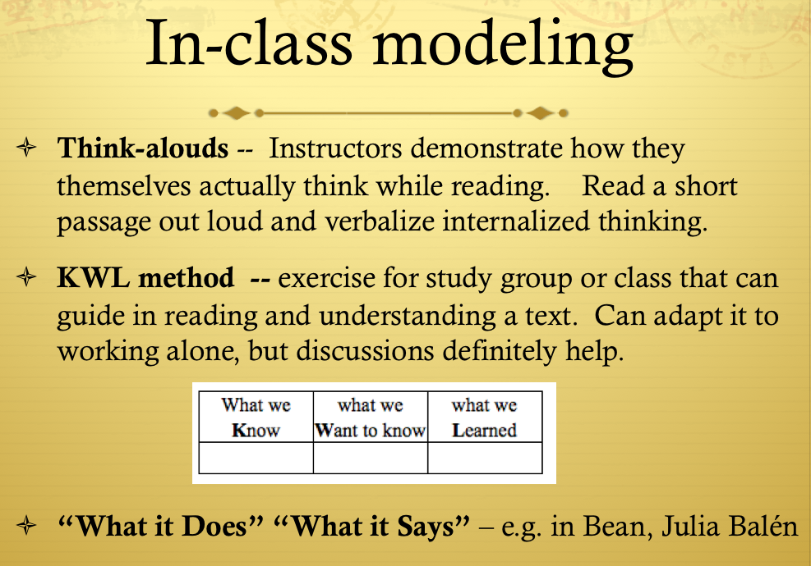
Learning Communities Best Practices
Collaborating with a mentor
Low-stakes writing assignments
Culturally-responsive pedagogy
Active-learning strategies
Teaching Quantitative Literacy
Teaching Reading Strategies
Teaching Critical Thinking and Reasoning
Battling Plagiarism
Outcome-based Assessment of GE SLOs
UNIV 150 Faculty Development
Cross-Training Exercise Activity
One-to-one communication

Slide 15
RESEARCH ANALYSIS
Conceptual Model: Purposeful pathways to first-year student success
Quintero, A. M. (2015). Purposeful pathways to first-year student success: Examining integrative high impact practices
at a Hispanic-serving institution. Available from ProQuest Dissertations.

Slide 16

Impact on First Year Student Success
First-Term Student Success Outcomes

Slide 17
Summary of Findings
1. HIPs matter to student success and educational equity.
  Results demonstrate that FYE participants achieved greater gains on all first-term student success outcomes, compared to FYE nonparticipants who transitioned to college with better odds of succeeding in the first term.
2. Well-designed HIPs matter to student success.
Student assessment data show that the intentional structuring of multiple HIPs and the strength of the linkages within the FYE experience (i.e., linked learning community, collaborative assignments and projects, and embedded peer support) matter to academic and social transition in the first term, engaging classroom environments, and students’ self-perceptions of their academic success.
3. Purposeful connections to HIPs matter to the success of underserved students.
Despite being identified as “at risk” pre-college summer bridge participants, FYE participants who were required to participate achieved greater gains on all first-term student success outcomes compared to FYE nonparticipants.
4. Institutional intentionally matters to student success.
Integrative and purposeful HIPs were found to interrupt the negative effects of student background characteristics and pre-college experiences by increasing the odds of student success for all FYE participants in the first term.
What is good for underserved student populations is good for the general population; HSI (Title V) funds support innovations that benefit all students.
Institutions can change their practices to create a more level playing field to reduce disparities in academic achievement, academic performance, and persistence.
FYE nonparticipants experienced:
    Higher odds of being on academic probation in the first-term
    Increased likelihood of lower first-term academic performance
    Lower rates of persistence to the second-term and second-year

Slide 18
Impact on Student Success
Retention rates are higher than others students for years 2 through 4 (2012 cohorts through 2014), but this did not result in better 4 year graduation rate for the first and smallest cohort. Retention and degree progress data bode well for 4 year graduation rate for F2013 and F2014 FYE participants.
In the beginning, FYE students had lower GPAs at beginning of years 2, 3, and 4. The gap has closed in each subsequent year and the fall 2014 cohort had a higher GPA at the beginning of year 2 than the rest of the freshmen.
Initially fewer FYE students were progressing in terms of units completed. Over next three cohorts, the gap has closed and now a higher percentage of UNIV150 students are sophomores at the beginning of the year 2 in comparison to all other students in their matriculation cohort.
AS WE GET BIGGER, WE GET BETTER
http://www.csuci.edu/islas/universityexperience/program-impact-video.htm

Slide 19
SCALING UP 1
 | All FTFT | FYE FTFT (U150/E UEA LC) | FYE as % of all FTFT | # FYE links | # FYE also Living- Learning
Fall 2011 | 602 | 77 | 13% | 4
Fall 2012 | 732 | 98 | 13% | 5
Fall 2013 | 823 | 118 | 14% | 6
Fall 2014 | 929 | 173 | 19% | 10
Fall 2015* | 905 | 171 | 19% | 9 | 3
Fall 2016** | 968 | 240 | 25% | 12 | 3
FYE is open to all freshmen, though not all freshmen have the opportunity (yet?).
Raw enrollment figures, FTFT status not-determined. Five STEM
Collaborative UNIV 150 sections without UEAs excluded from data.
** Estimated enrollment, FTFT status not-determined

Slide 20
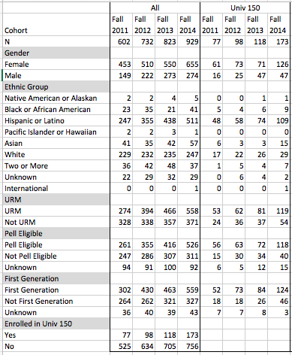
SCALING UP 1
The percentage of freshman cohorts that are underrepresented minority, Pell-eligible, and First Generation is increasing as CI grows. The relative participation of these groups is even higher in FYE.
FYE program has higher impact on these groups, particularly for fall 2014 group, which had largest numbers of all years.

Slide 21
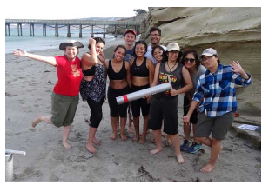
SCALING UP 2
First-Year Communities
RISE STEM Academies 2015
UNIV 150 and Chemistry linked with English and Communication
Developmental Math linked with Stretch English
Peer mentors run study sessions, cross-train with PEEPs
Student Undergraduate Research Fellows, or SURF
year-long multi-course LLC model with Channel Islands theme
anchor first year interdisciplinary research seminar (UNIV 198)
DIGs with Research Ambassador Mentor
Fall 2016 two tracks: a STEM track with UNIV 198 and Biology, and a Social Science Humanities track with UNIV 198, Anthropology, and English.
  Both tracks take ANTH/ESRM team-taught class on natural history of the Islands together.
  Students in both cohorts continue in a block of courses in the Spring.

Slide 22
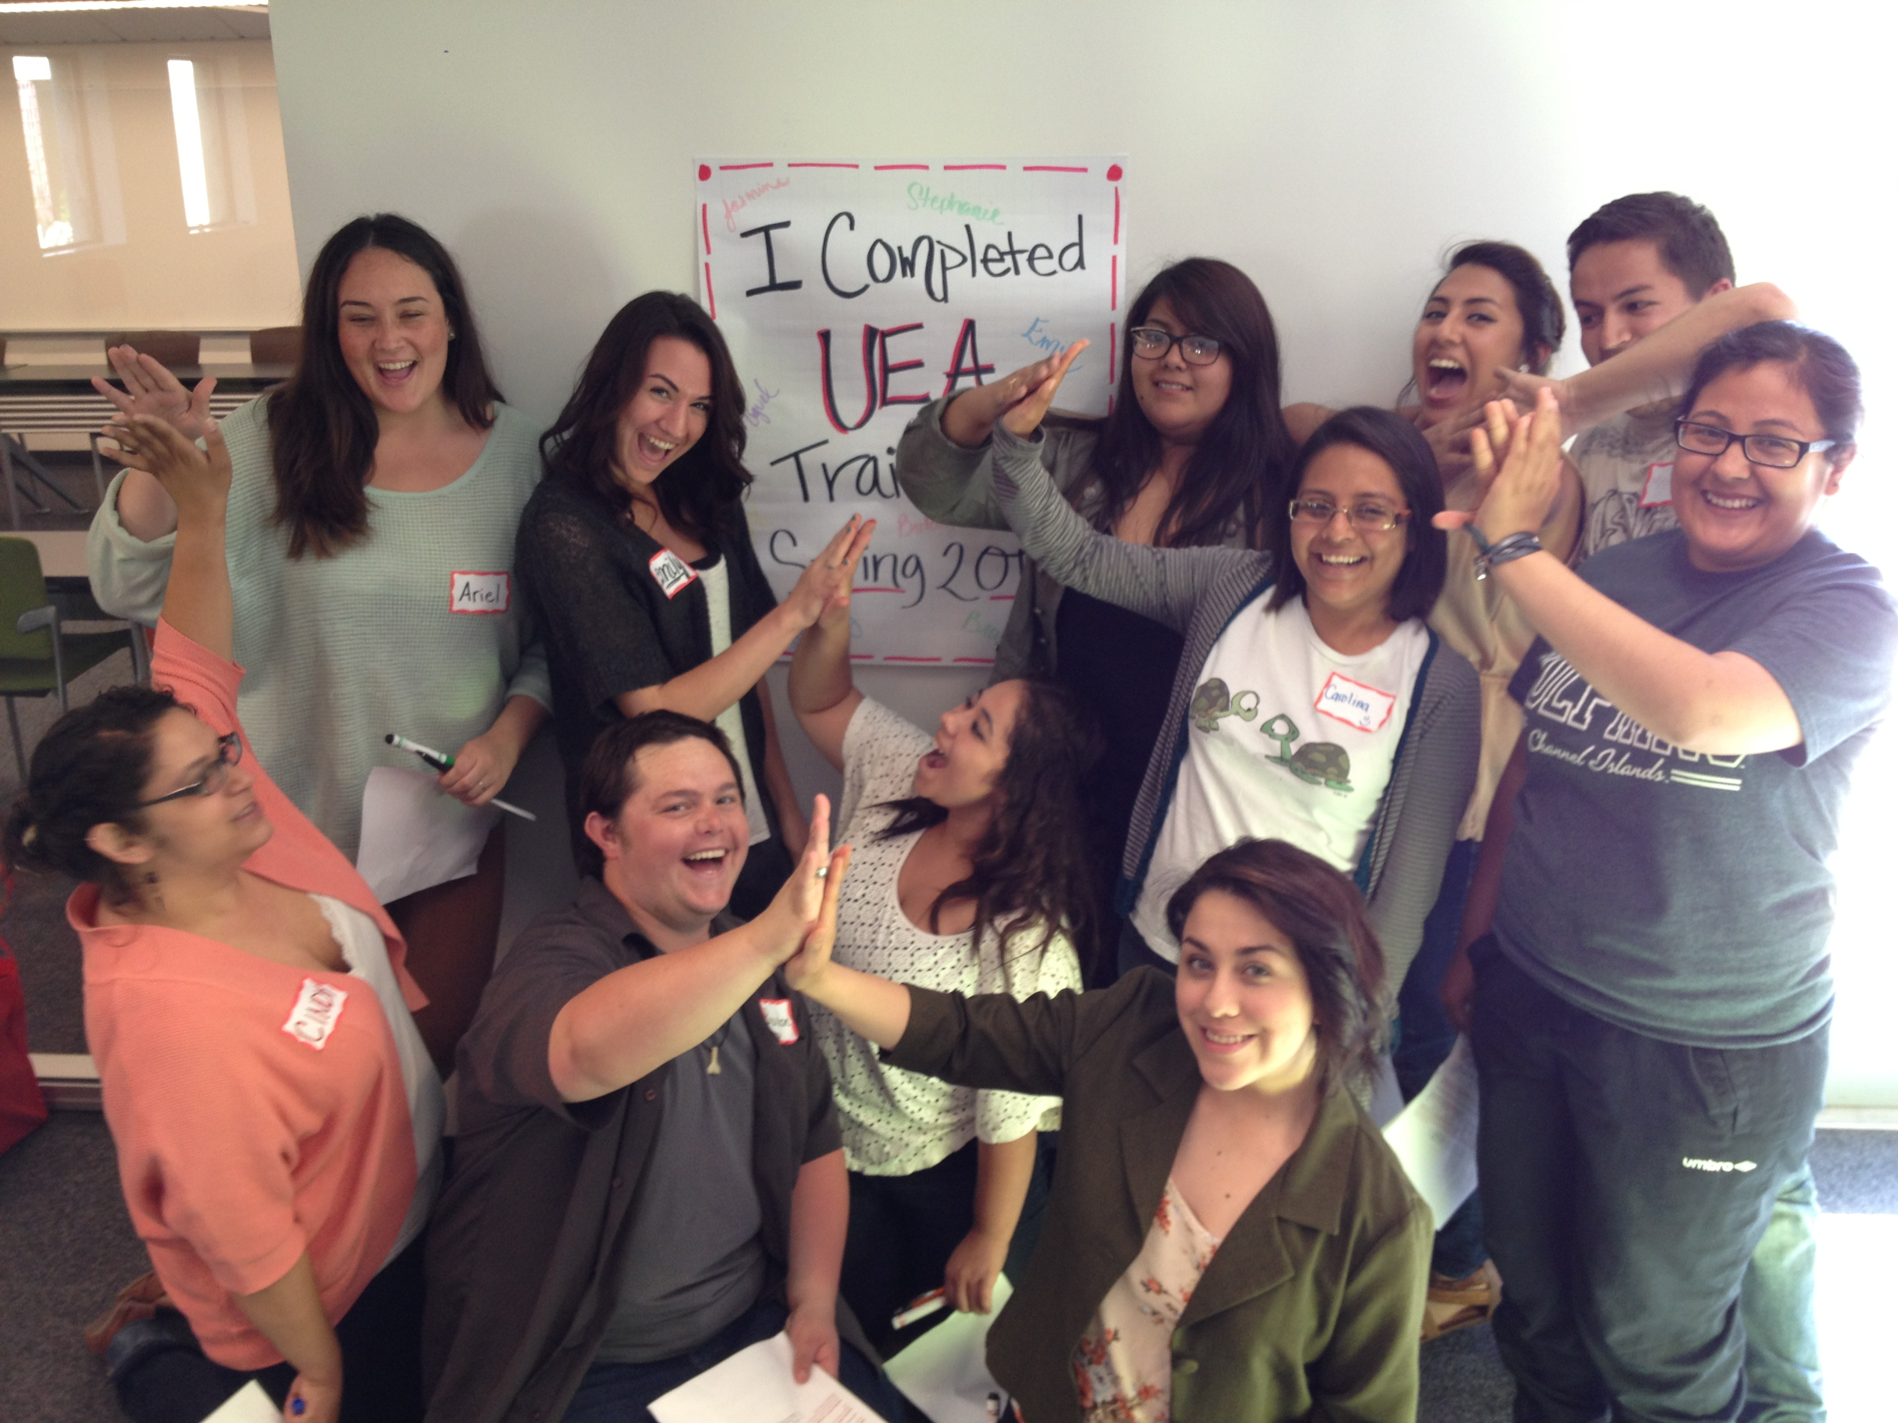
Peer Mentoring is a “high impact job”
Last day of training for cohort 3 of the University Experience Program. Eight of these eleven mentors served in First Year Experience.
Seven have graduated and are now working in higher education, telecommunications, social work, and middle school teaching.

Slide 23
TAKE AWAYS?
What did you learn about the high-impact practices integrated into CI's FYE?
How might you promote these retention strategies on your own campuses?

