Slide 1
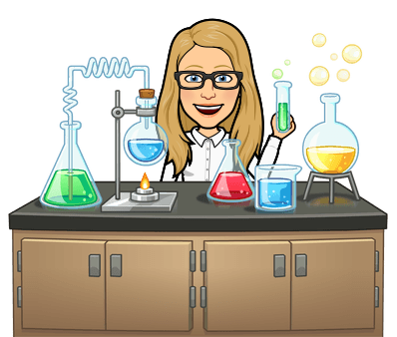
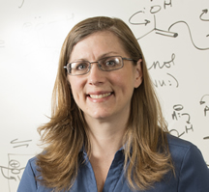
Are the students laughing at my jokes? How to connect and build community in the times of COVID-19
Dr. Laurie S. Starkey
Cal Poly Pomona
Bitmoji

Slide 2
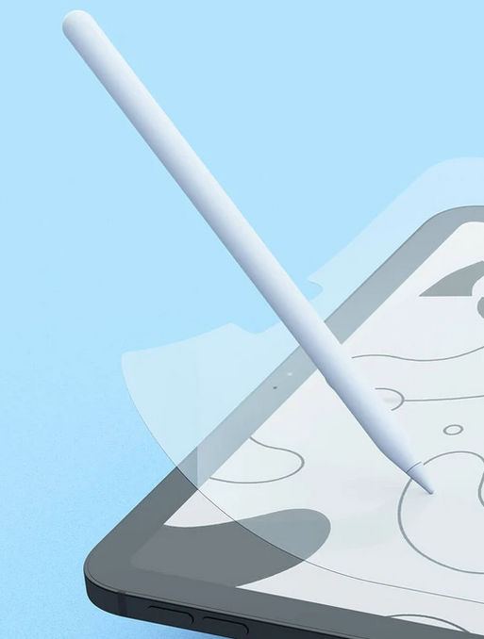
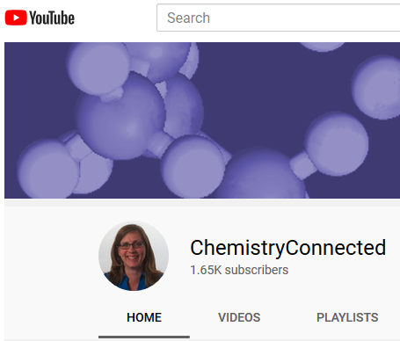
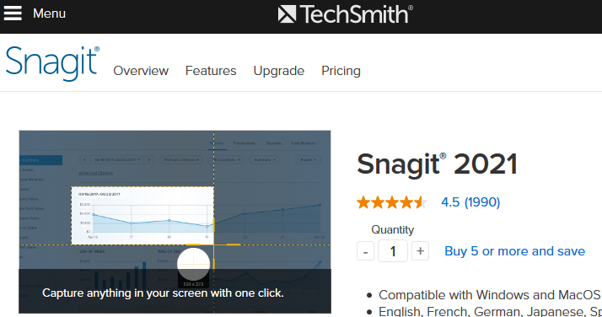
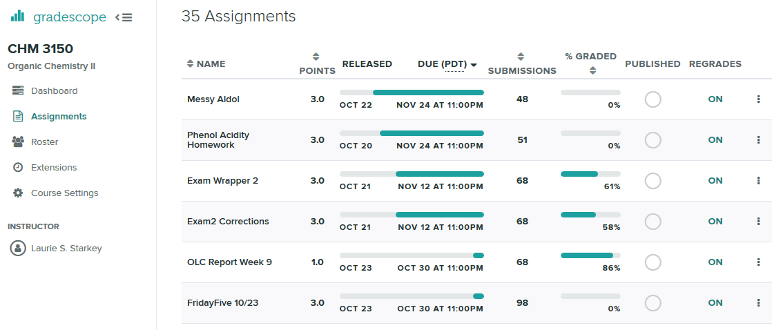
Ten Weeks in: Lessons Learned
Invest in an iPad (Apple Pencil, Paperlike screen protector)
Gradescope to manage student work
Genius Scan to make PDF w/phone
Use a headset
Get a good snipping tool (Snagit)
Create a YouTube channel

Slide 3
Keeping Students Motivated
Motivate Lab training
Starting Strong course
Growth Mindset
Purpose & Relevance
Sense of Belonging

Slide 4
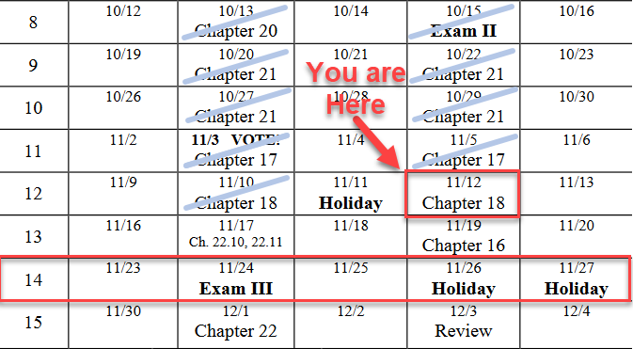
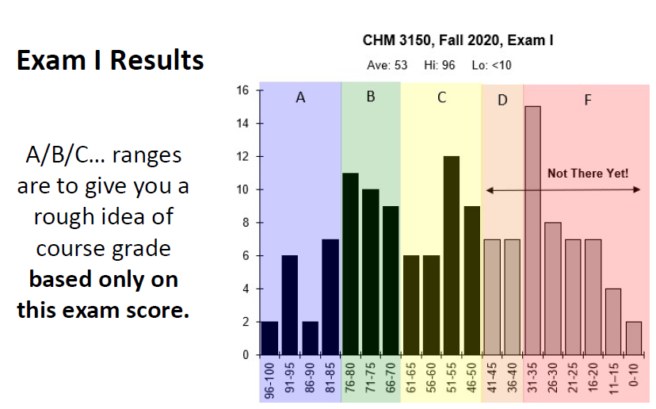
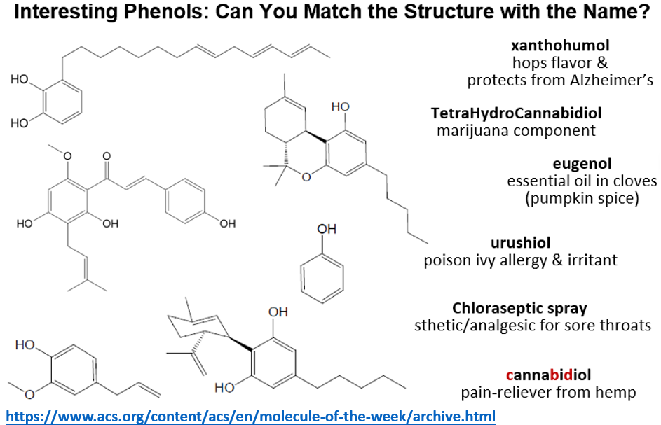
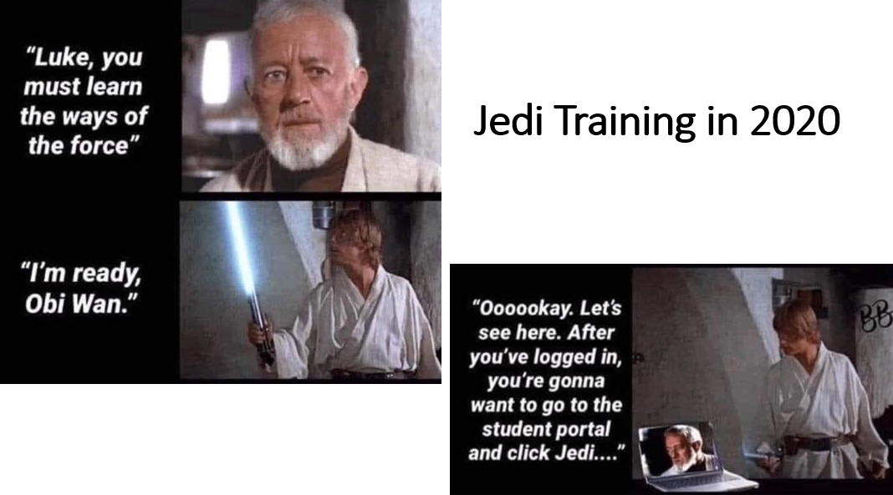
That Awkward Zoom Time Before Class Starts…
Turn on video so you can make a toast (coffee cup)
Show live animal cams from Explore.org
Loop a PowerPoint slideshow with course announcements, memes, student photos

Slide 5
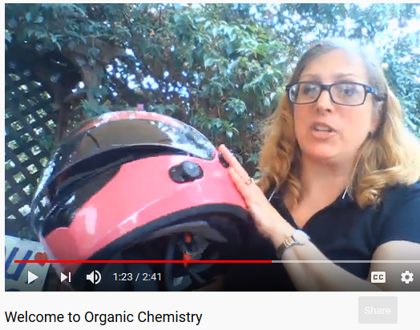
Make a Course Introduction Video
Introduce yourself & your course
Share your passion
Starting Strong…
Growth Mindset
Purpose & Relevance
Sense of Belonging
Include link in Welcome E-mail

Slide 6
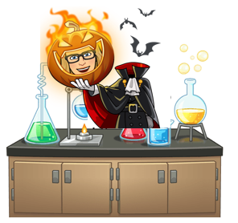
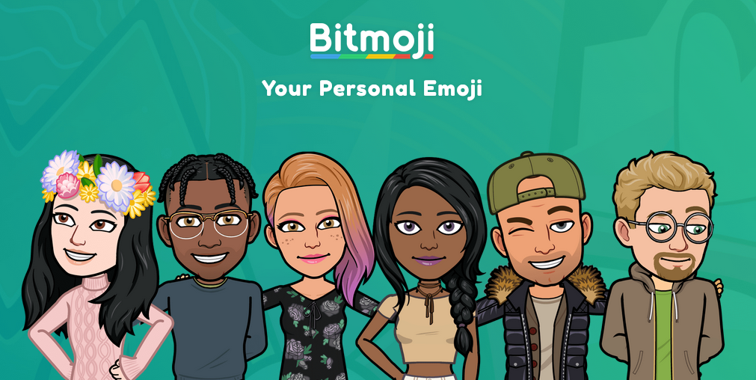
Animate Yourself

Slide 7
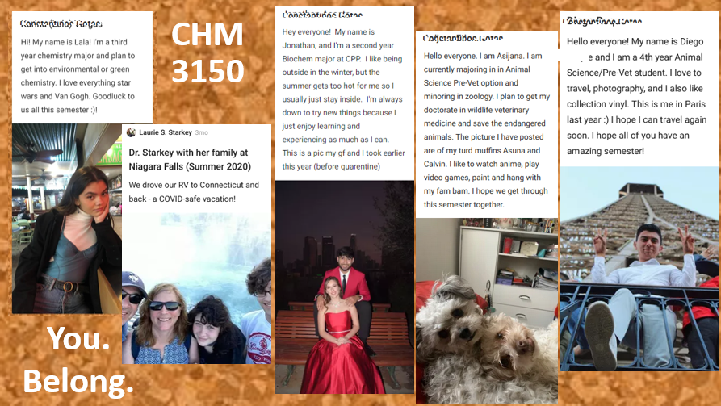
Padlet.com for Student Introductions

Slide 9
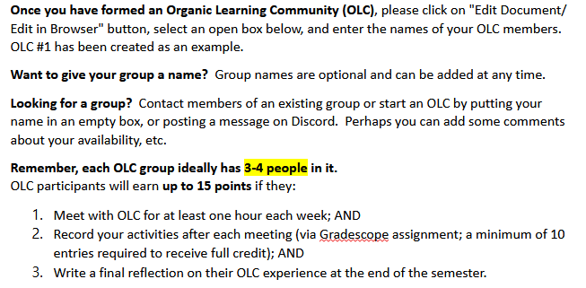
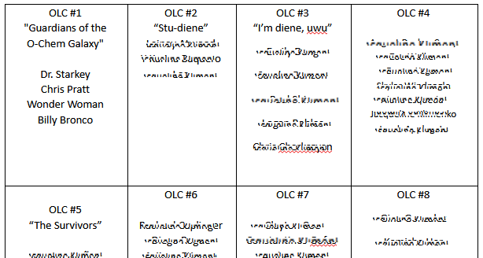
Study Groups for Student Interactions
Organic Learning Community (OLC)
Offer credit for weekly report w/selfie pic

Slide 10
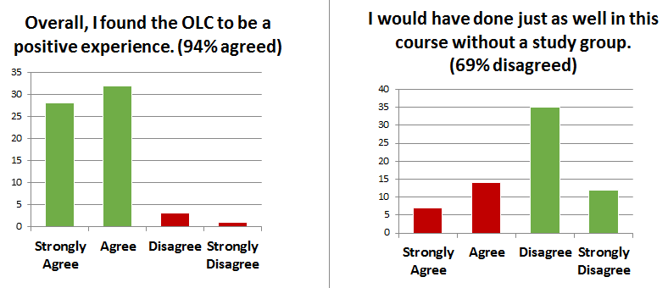
Study Groups for Student Interactions
Organic Learning Community (OLC)
Students report positive, helpful experience

Slide 11
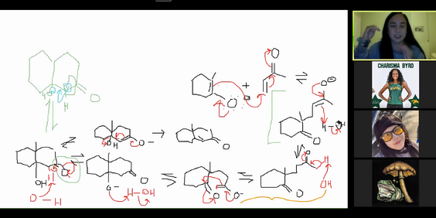
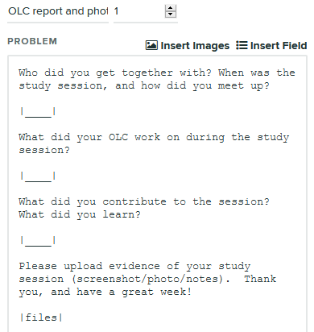
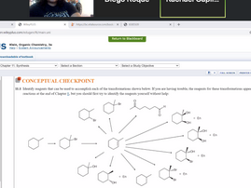
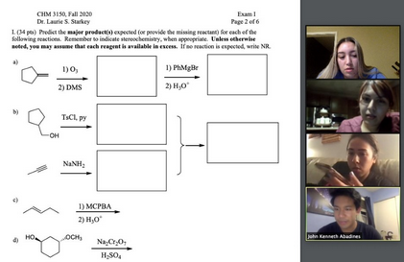
OLC Reporting

Slide 12
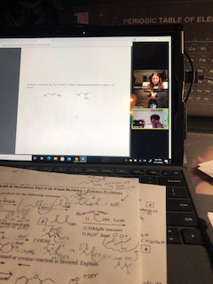
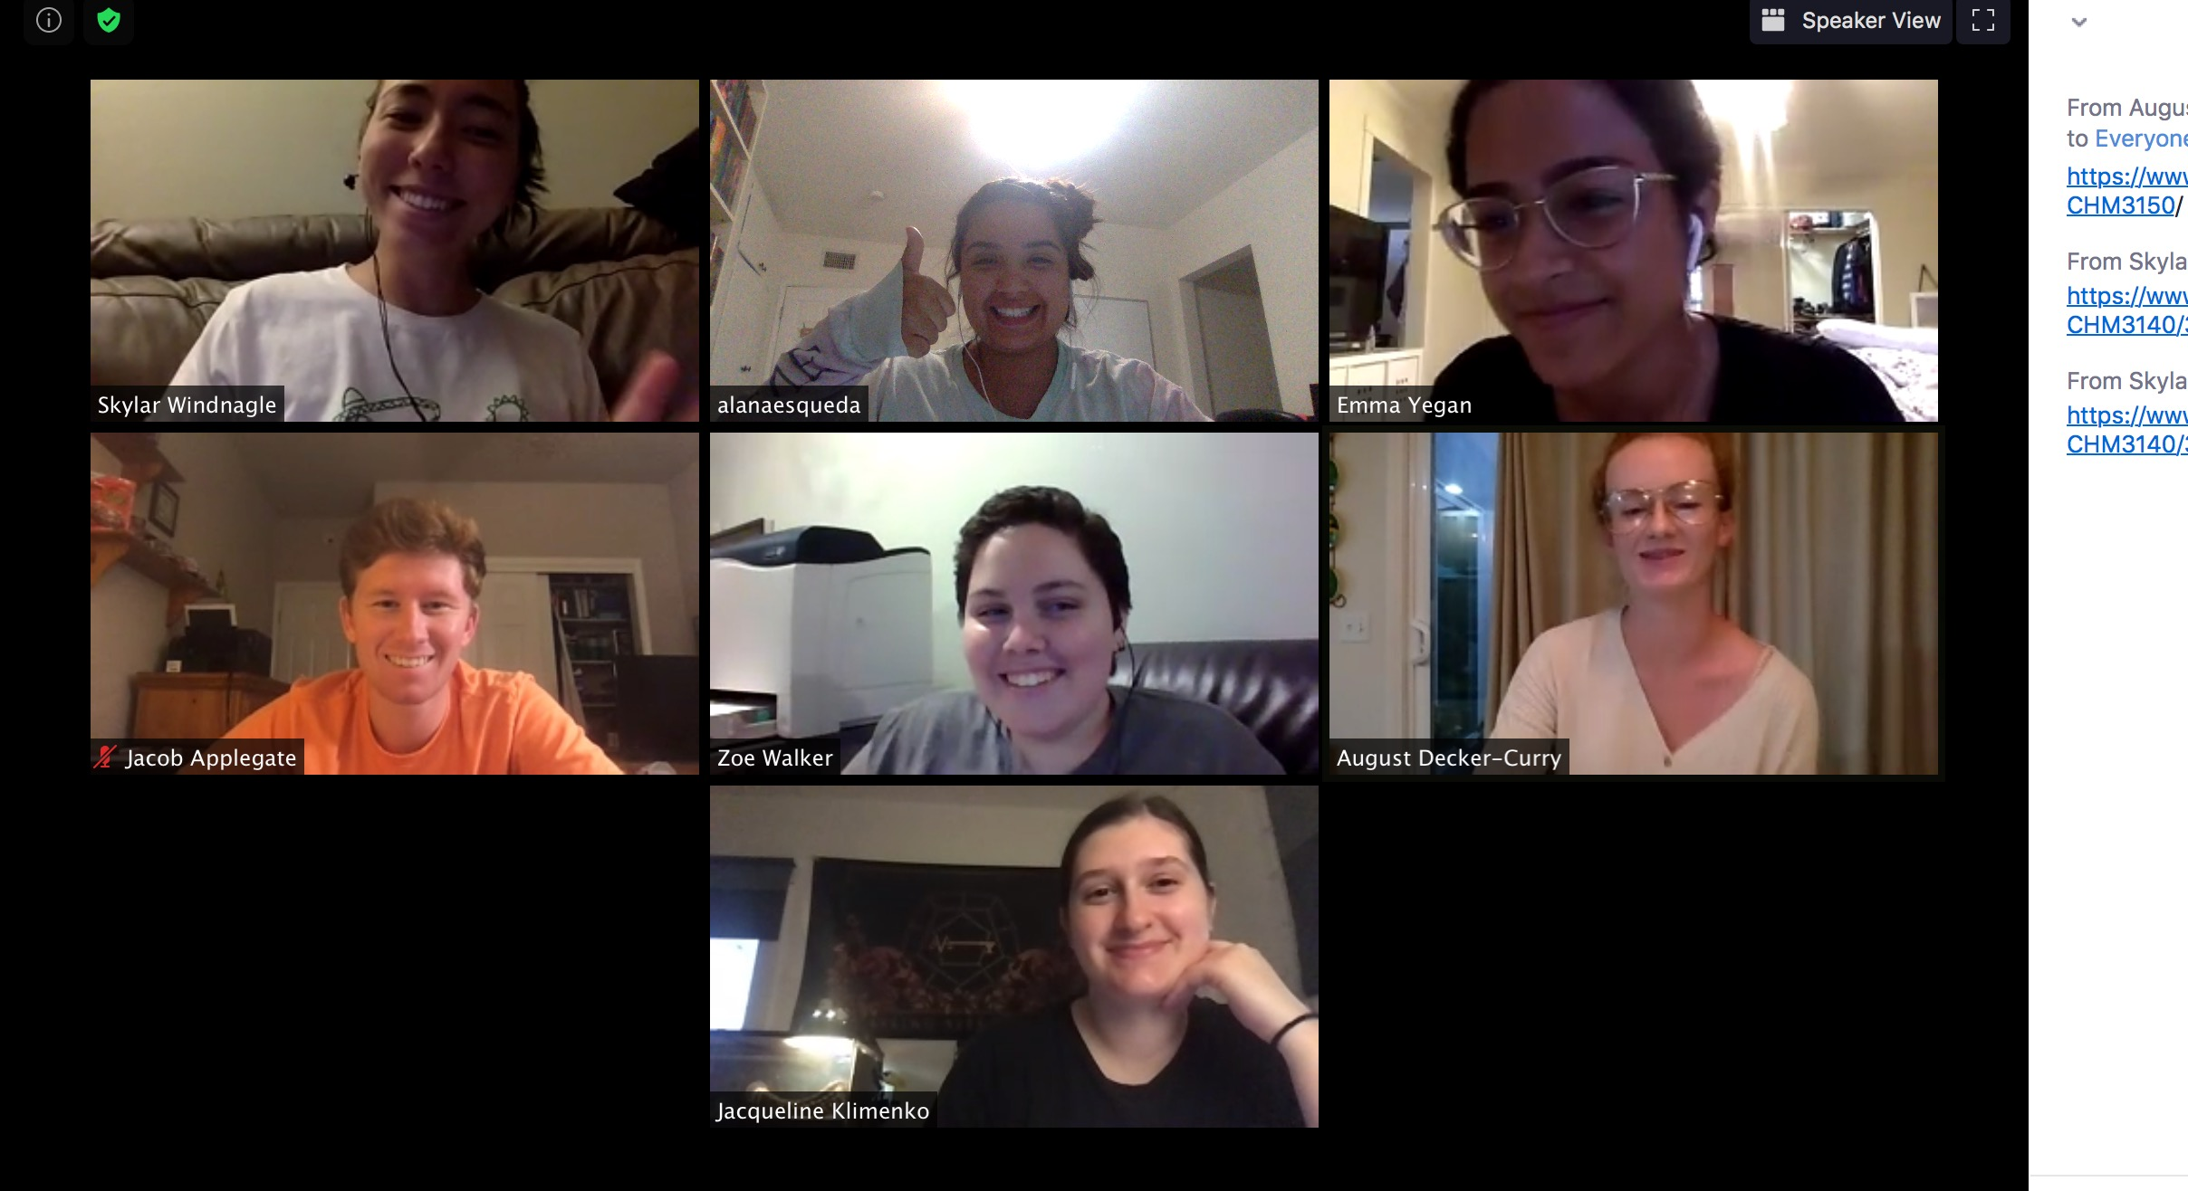
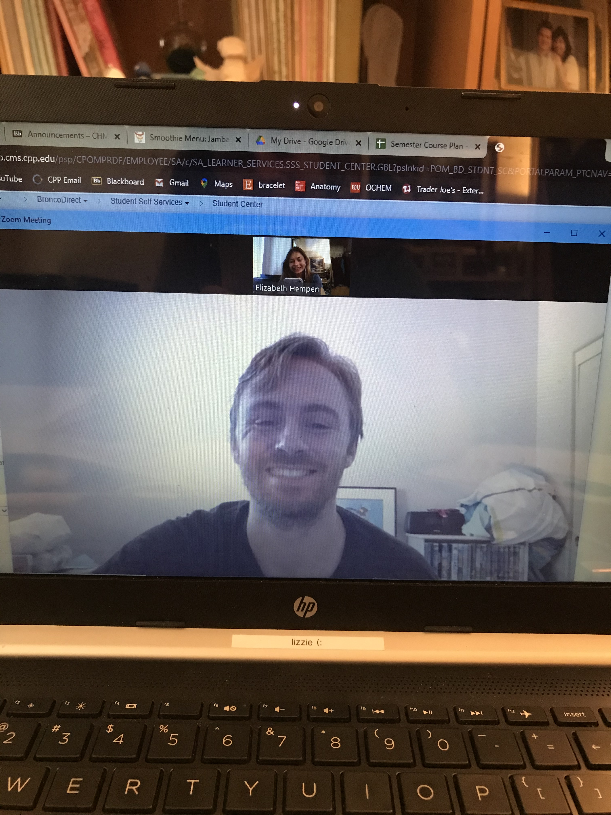
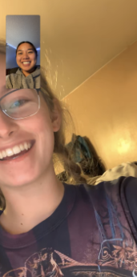
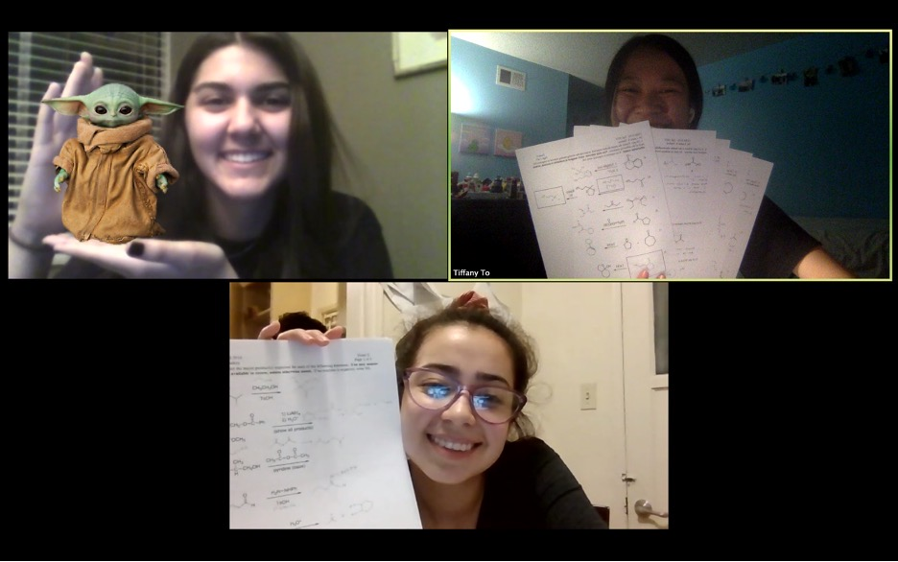
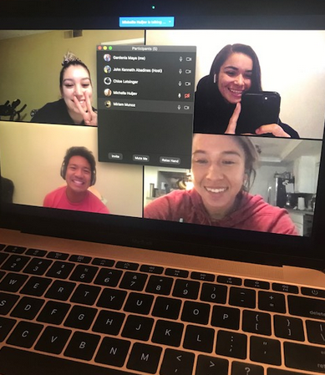
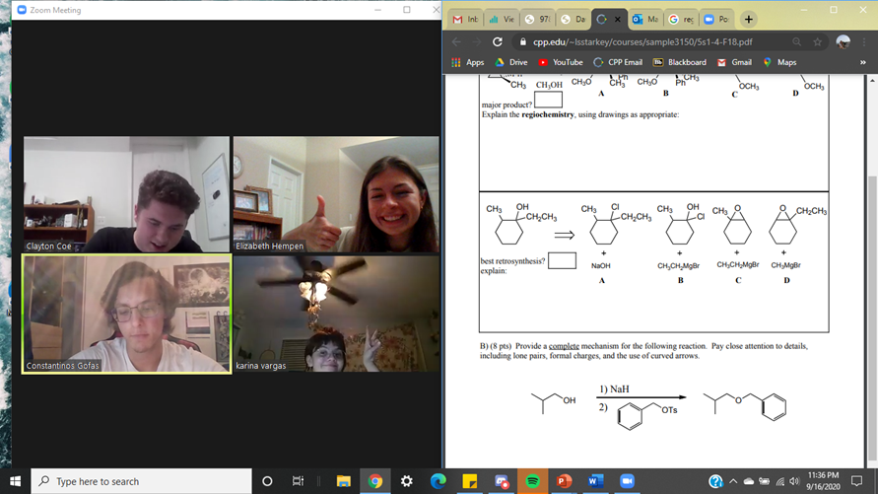
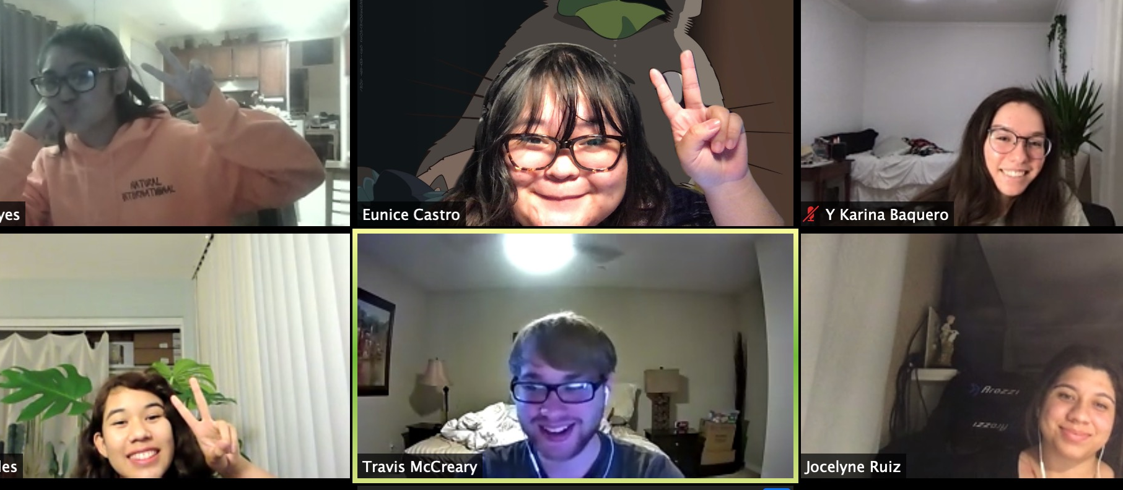
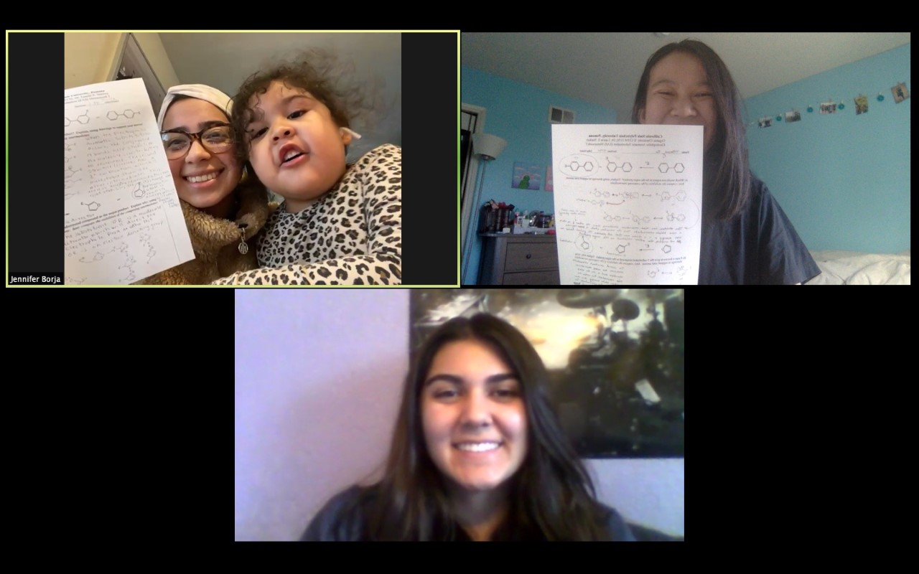
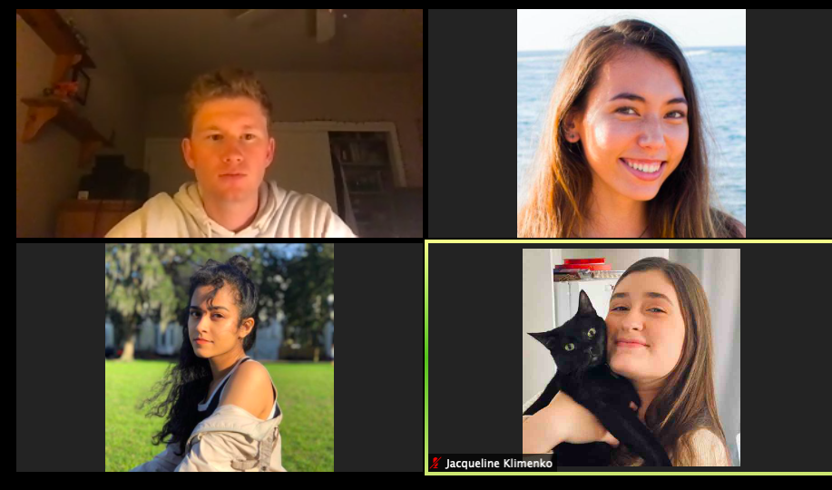
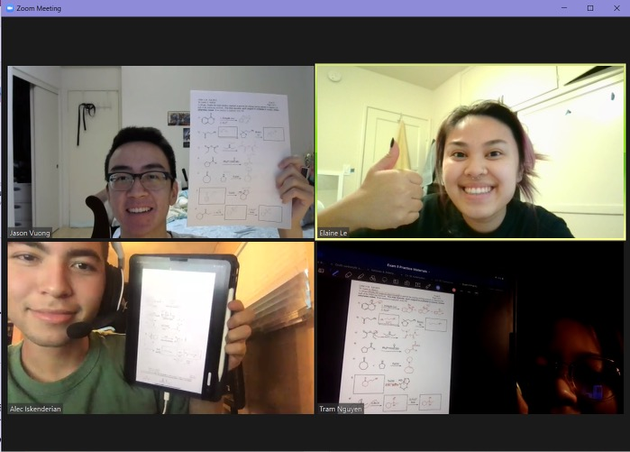
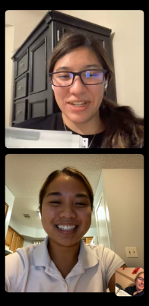
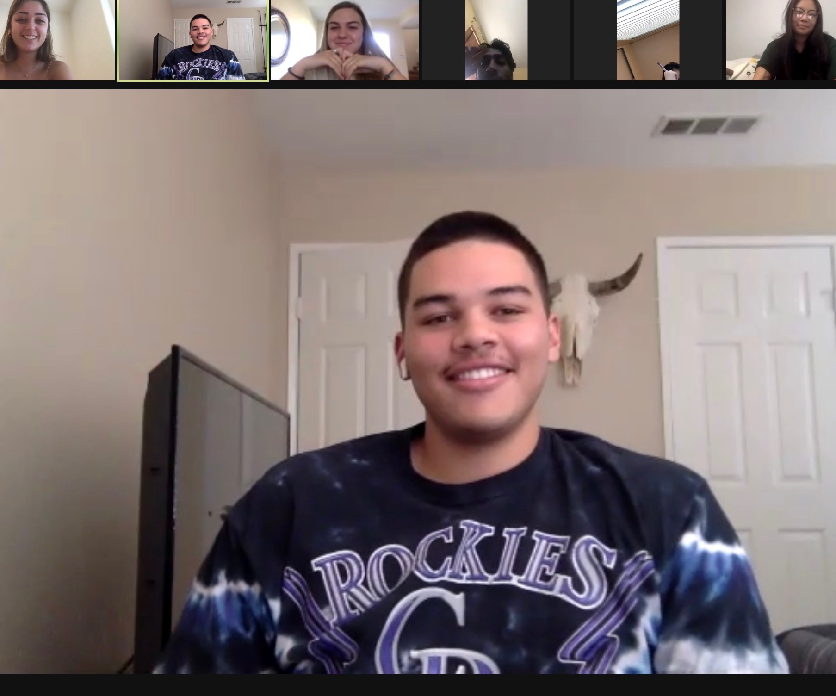
OLC
Study Groups!

Slide 13
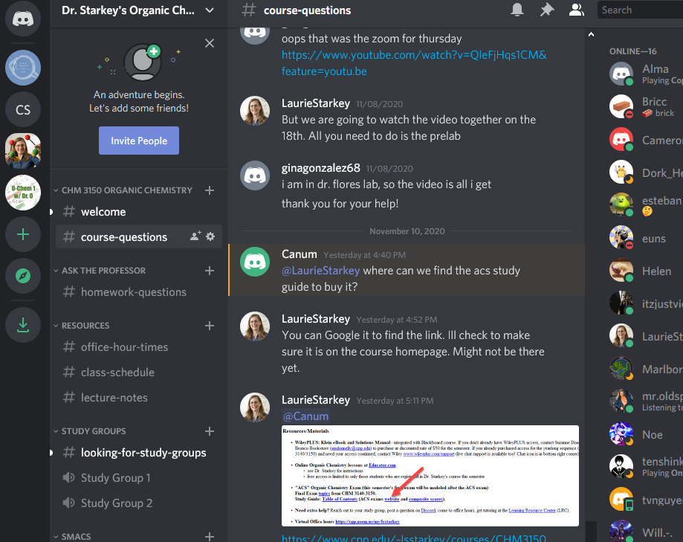
Fostering Communication
Discussion boards
Google Voice (texting)
Discord server
instructor/student Q&A posts
student/student
Familiar to gamers
https://discord.gg/m6gQWE
13

Slide 14
Fostering Metacognitive Reflection
Exam Wrappers
“Friday Five” Weekly Reflection
Describe how you spent your time working on Organic Chemistry this past week.
Describe your plan for working on Organic Chemistry this coming week.
3rd prompt…promotes Purpose, Relevance, Value
…and it’s a wonderful way to connect!
14

Slide 15
“Friday 5” to Motivate & Make Connections
Add a Zoom profile picture
Battling Zoom fatigue. One thing that makes Zoom more engaging is knowing who is in the meeting or virtual classroom. Your assignment this weekend is to log in to https://cpp.zoom.us and add a Profile picture! A photo of you would be great, but you can also use an avatar or a pet pic, etc. Upload a screen shot here:
15

Slide 16
“Friday 5” to Motivate & Make Connections
Course Check-in: Start-Stop-Continue
How is CHM 3150 going so far? We all had SO much to navigate at the start of the semester, but hopefully you are finding your groove and falling into some sort of new-normal routine. Do you have any feedback for me? Is there anything you wish I would do differently, or stop altogether? Anything that is working well that you want me to continue? Please share!
16

Slide 17
“Friday 5” to Motivate & Make Connections
Mental Health Check-in
This year our nation reflects on the events of 9/11/2001, at a time when we are facing another great upheaval - coming from several directions at once. There is no question your life has been disrupted in many ways since March. Like 9/11, the year 2020 will certainly go down in the history books, and hopefully what will be commemorated when we reflect on this time is our resilience and the triumph of science and a monumental shift toward a more tolerant and compassionate society. How are you doing? Have you developed some positive coping strategies as you adjust to the new normal?
17

Slide 18
“Friday 5” to Motivate & Make Connections
Showing gratitude
It is a Thanksgiving tradition to reflect on what we are thankful for. Going around the table and taking turns to express our gratitude is a wonderful exercise that can bring us all together. Wouldn’t it be nice to do that throughout the year? In fact, the practice of frequently focusing your attention on the positive aspects of life, can have a tremendous impact on your mental well-being and even your physical health! (Want scientific evidence?) Why not start a gratitude journal, or start sticking Post-It notes on a gratitude wall? Here is a website with many great ideas (here are the 13 most popular). There are even gratitude apps you can get for your phone! In the space below, write a thank-you note to someone, deeply reflect on something that made you smile recently, or describe in detail five things you love about your favorite place/friend/pet/ food/hobby/season/music... For more ideas, Google “Gratitude Prompts.”
18

Slide 19
“Friday 5” to Motivate & Make Connections
Encourage good study habits
Hopefully you have started making flash cards, as a simple way to stay organized and practice synthesis problems. Please upload a picture of your stack (or pile) of flash cards! If you haven't made any yet, you can upload a picture of whatever method you use to ACTIVELY review material. (BTW, making flashcards now would be a great way to review for the midterm. It's never too late to start making your stack!)
19

Slide 21
“Friday 5” to Motivate & Make Connections
Autumn activities?
Happy October! Do you have any activities you enjoy each fall? Watching sports? Going for walks? Putting up Halloween decorations? I am excited for NFL football to be starting, but I am sad that I won't be going to the LA County Fair this year. Share a bit about your favorite activities, and what you are looking forward to in October (perhaps starting some new traditions?).
21

Slide 23
“Friday 5” to Motivate & Make Connections
Tell me about your volunteer activities
A way to find purpose in life is to do something for others. Volunteer work contributes to the community and enriches our own lives at the same time! It might be harder to find ways to serve during the pandemic, but since March I have volunteered at a food bank, read to a kindergarten class via Zoom, and donated blood. My daughter spent two years in high school as a "cat socializer" at an adoption facility in a pet store! Tell me about your volunteer activities - something you've enjoyed doing in the past, or what you're currently doing, or perhaps what you'd like to do someday.
23

Slide 24
“Friday 5” to Motivate & Make Connections
Finding relevance in Organic Chemistry
One thing that makes this course relevant to your life is that you interact with organic compounds all day, every day! Your mission for this Friday Five is to find an interesting organic molecule. Upload a picture, tell me its name and write a few sentences about it (What functional group(s) are in it? Where does it come from? Is it natural or man-made? What is it used for? What makes it interesting?) Try exploring at the ACS "Molecule of the Week" archive. Can you find a molecule that starts with the same letter as your first or last name? Can you find a molecule that is a ketone, aldehyde, carboxylic acid or carboxylic acid derivative? https://www.acs.org/content/acs/en/molecule-of-the-week/archive.html
24

Slide 26
“Friday 5” to Motivate & Make Connections
Sharing a love of science
Let's celebrate National Chemistry Week! Every year the CPP chemistry club (SMACS) conducts science demonstrations at the Santa Ana Zoo for NCW. There was no live event this year, but there are lots of online materials assembled by the American Chemical Society (ACS). Please explore the ACS NCW website and reflect on what you find there. https://www.acs.org/content/acs/en/education/outreach/ncw.html
Some possible responses: What was your favorite demo/activity/article/etc.? Do you recall any fun or interesting demos you saw when you were younger? Have you ever watched Bill Nye (aka The Science Guy)? Have you ever shared science activities with kids? Is there something at the ACS website you could share with a younger sibling, neighborhood kids, or local school? Science is fun!
26

Slide 27
Will students participate? Yes, if rewarded!
Advice: to discourage online cheating, avoid high-stakes exams.
Result: complete revision of pre-COVID grading scheme!
F2F Course Points (400)
* 3 midterms (300 points)
* final exam (100 points)
Homework, exam wrapper, OLC worth ~5 points XC on each exam
Remote Course Points (500)
* 3 midterms, drop lowest (200 points)
* 1 final exam (100 points)
* Homework (125 points, 25%)
* Reflection/OLC (75 points, 15%)
Friday Fives, OLC, exam wrappers

Slide 28
Offer Synchronous Activities (aka Live Show)
Students can ask questions, provide feedback
YOU can ask questions
Breakout sessions for discussion, problem-solving
Builds community
Preferred by students: online overload, getting what you pay for
Disadvantages…
Minimal student participation (Is anyone laughing at my jokes?)
Students are reluctant to use video
Can be exhausting
Equity concerns (Always make recordings available!)

Slide 29
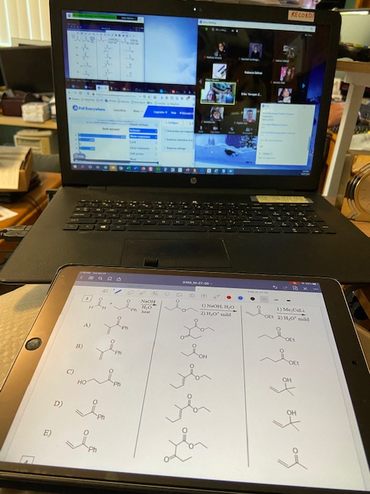
My Online Classroom
Laptop (Zoom & Webcam)
Clock!
iPad (Zoom
& GoodNotes)

Slide 30
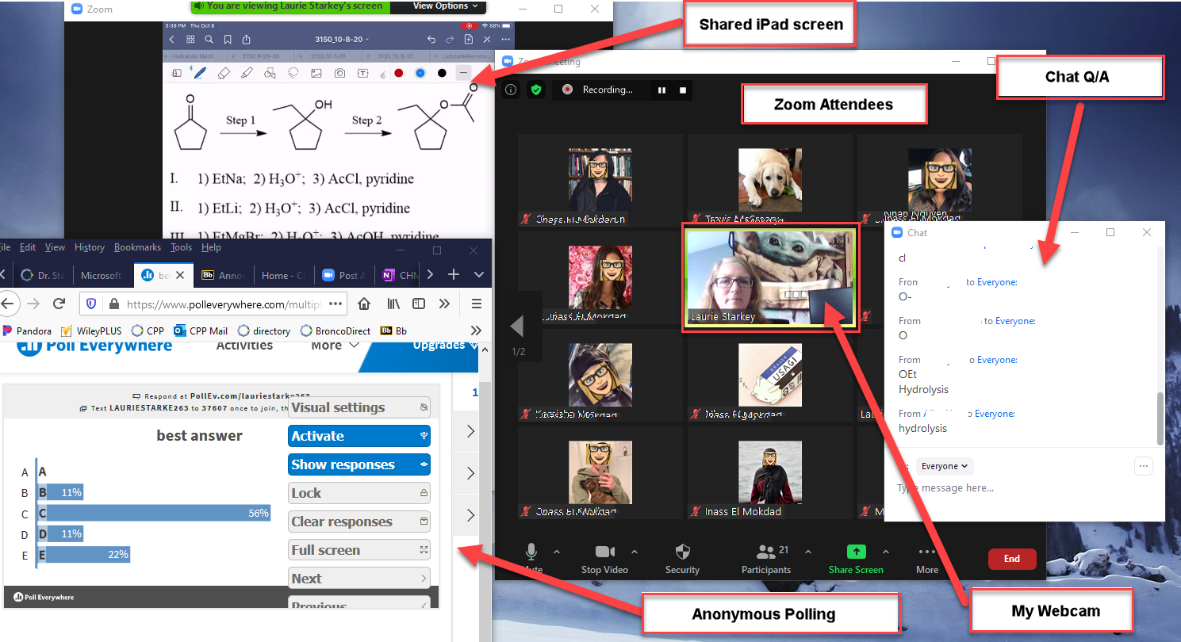
How to: Teach Synchronously & DRAW Using Zoom

Slide 31
How to: Teach Synchronously & DRAW Using Zoom
Provide worksheet or skeleton notes as PDF
ChemDraw, PowerPoint, Word
Hand-written notes captured with Genius Scan
Start Zoom session on laptop for best functionality
Webcam for video of me
Full keyboard for chat
presenter tools easy to find/use
can share screen to show LMS/websites/VitalSource text
Join Zoom session with my iPad or phone and share screen
Do NOT join audio on iPad (otherwise, echo/feedback!)
Phone camera can capture you writing on paper
iPad apps to mark-up PDF (solve problems, annotate notes)

Slide 32
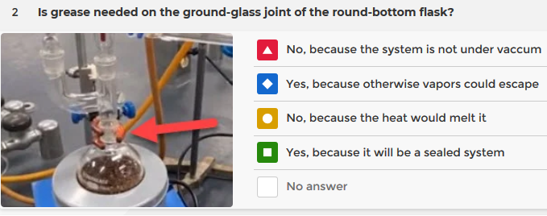
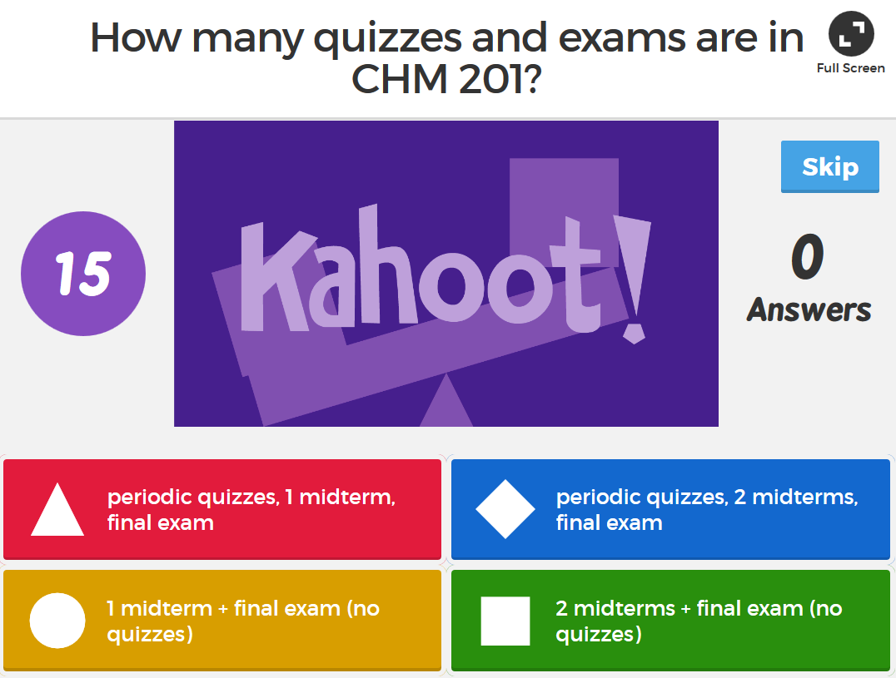
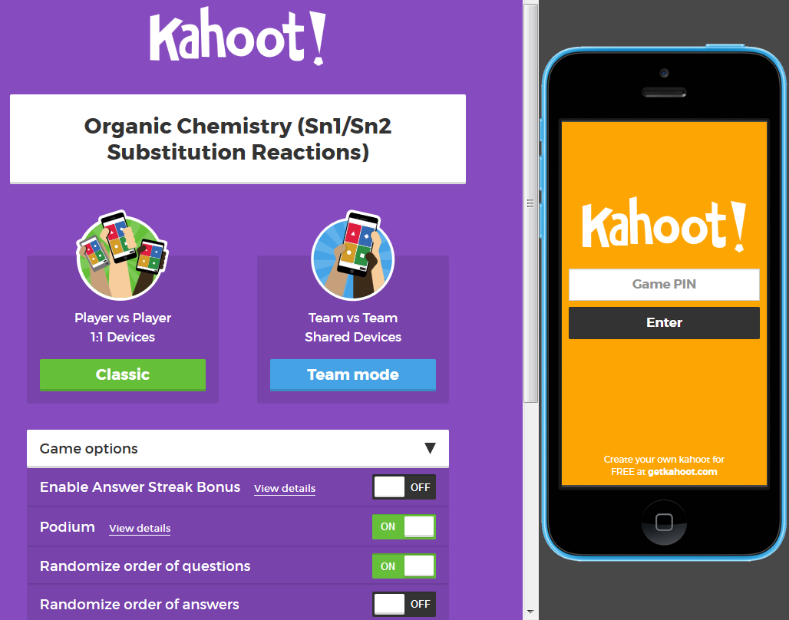
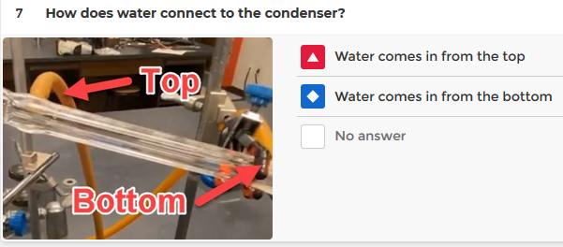
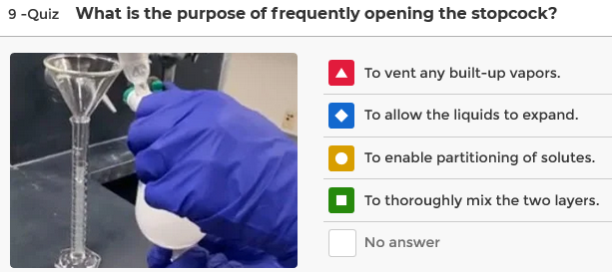
Tech-Enabled ENGAGEMENT using Kahoot!
Clickers on steroids…FUN, gameshow-style multiple-choice questions using mobile devices (good for syllabus “quiz,” exam review, “inquisitive” lab interactivity and more Kahoot)

Slide 33
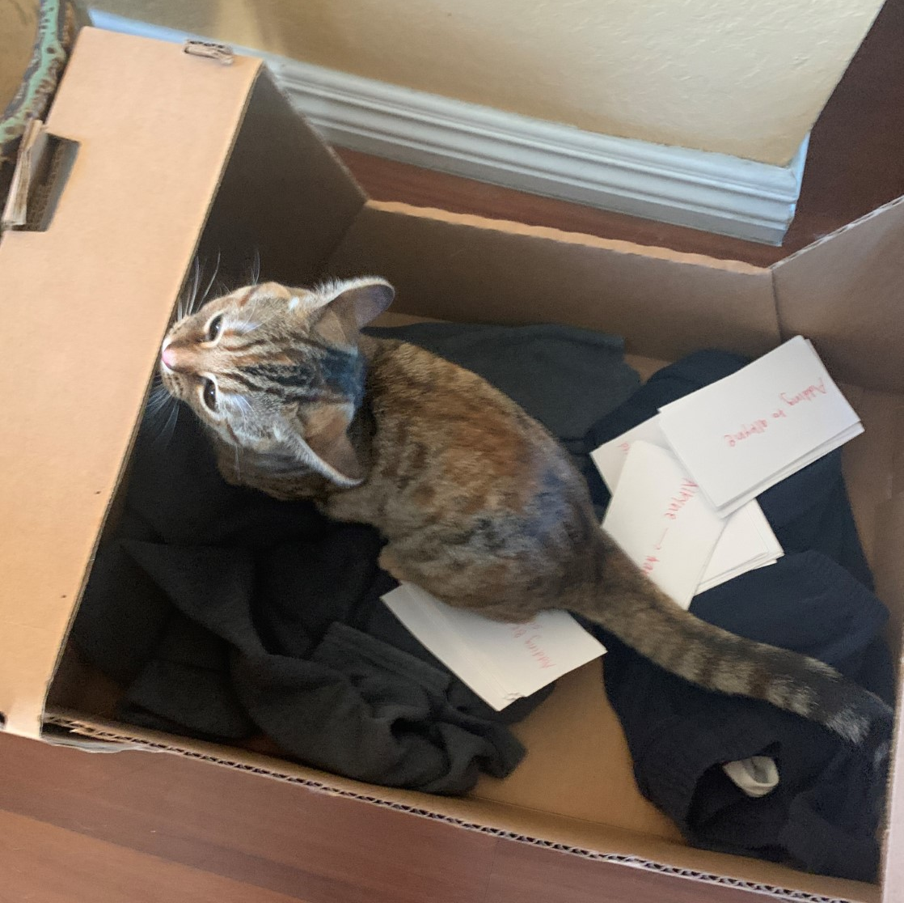
I am grateful for the relationships we have built!
Professor Starkey,
I know you are a cat mom so I thought I would share this photo of my kitten! I found her with my chemistry flashcards one morning in her favorite box. Not sure how she was able to pull that off. Hope you enjoyed 🙂

Slide 34
Making it Work: Staying Happy, Healthy & Sane
Be Patient
Be Flexible
Be Open to Try New Things
Be Honest with Students
Don’t Reinvent the Wheel
Don’t Obsess Over Cheating
Don’t Try to be a Superhero
Connect with Colleagues
Use Facebook Groups
#AllInThisTogether

Slide 35
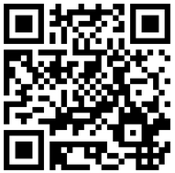
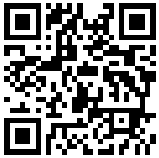
Thank you for joining me!
Questions? Use chat or raise hand or email me…
Mindset & Video resources
lsstarkey@cpp.edu
COVID-19 remote teaching resources

